Slide 1
Online Resources
From Oxford University Press

Slide 2

This presentation gives a brief description of
Oxford Medicine Online
It tells you
what Oxford Medicine Online is
how it can help you
how to look for information in it
The presentation will take about 5 minutes

Slide 3
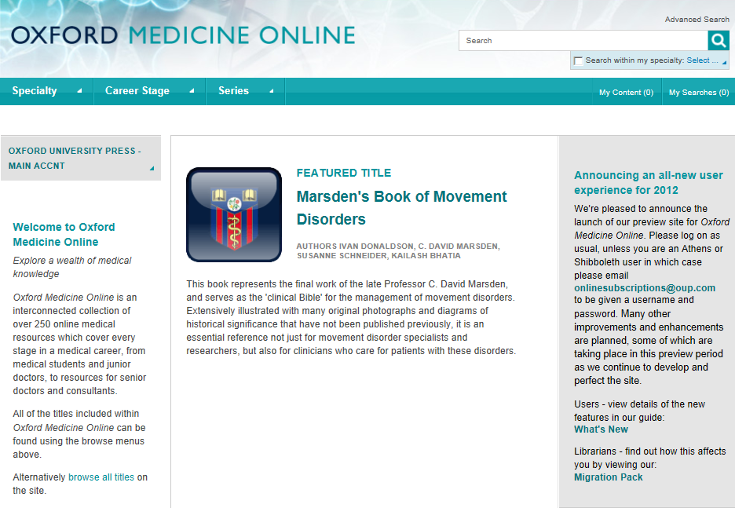
Oxford Medicine Online, relaunched in summer 2012, is an interconnected XML collection of online medicine resources which cover every stage of a medical career.
The portal provides access to high-quality trusted medicine content essential for all medical staff needing authoritative information quickly.

Slide 4
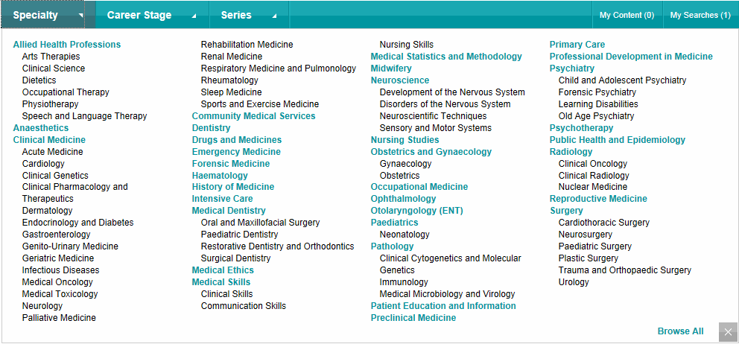

Content is organized in collections according to medical specialties...

Slide 5
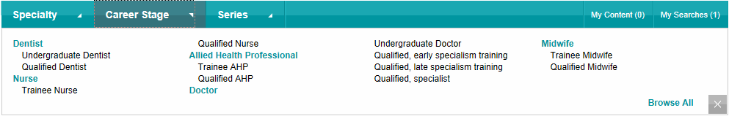
…career stage…

Slide 6
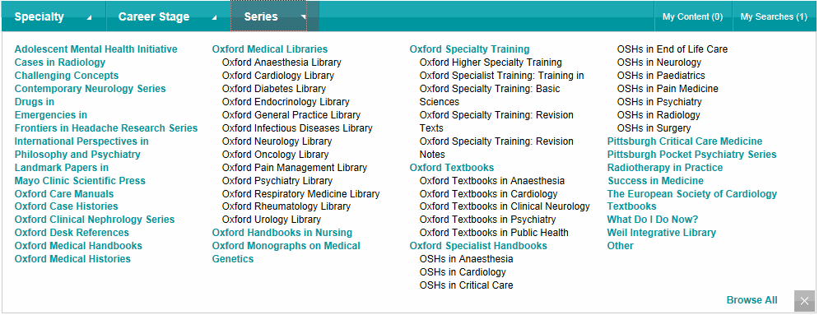
…and series.

Slide 7
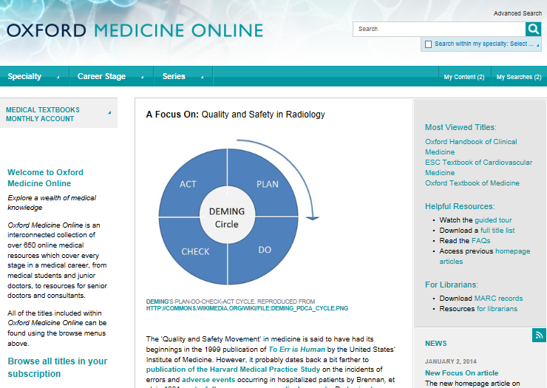
From the homepage you can download the full title list, browse all the titles in your subscription, check most viewed titles, subscribe to RSS feed to receive the most recent information…

Slide 8
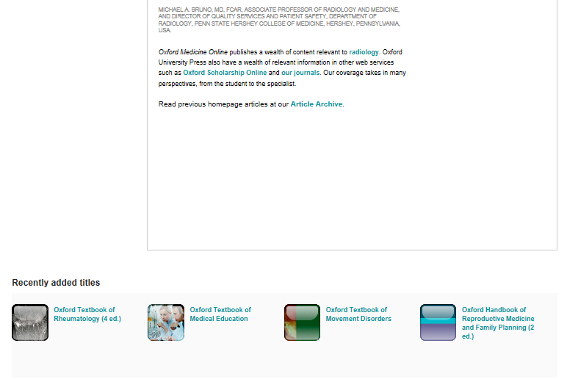
…and view the recently added titles.
You can also access the monthly article archive.

Slide 9
Click to browse a collection.

Slide 10
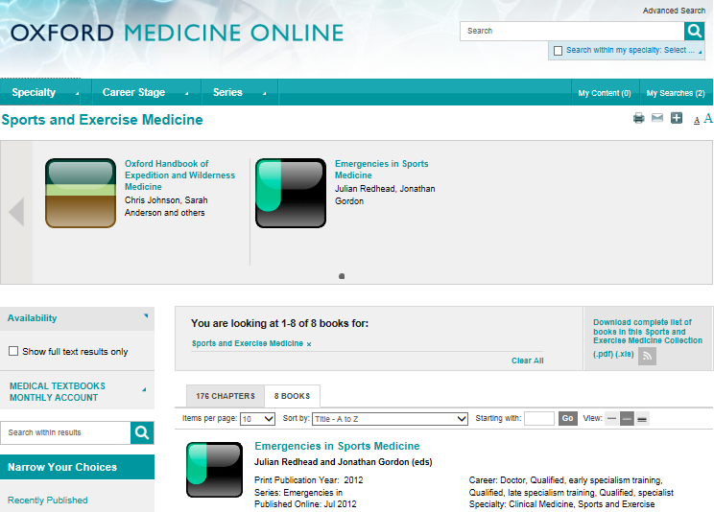
Display only those titles that your institution has full text access to.
You can download the full title list.
Display the results as books or chapters

Slide 11
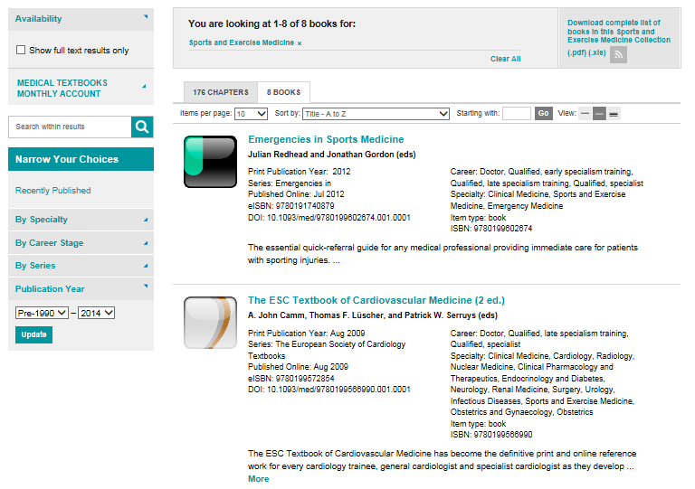
Note that you can search within the selected material…
…and narrow your choices by using the navigation panel on the left.

Slide 12
Facial oedema
To search the whole content, type your query into the box at the top of the page.

Slide 13
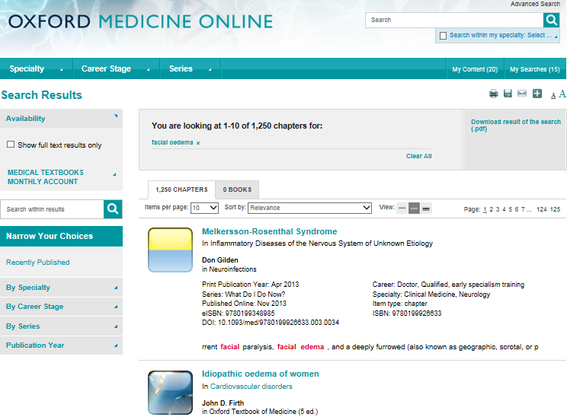

Slide 14
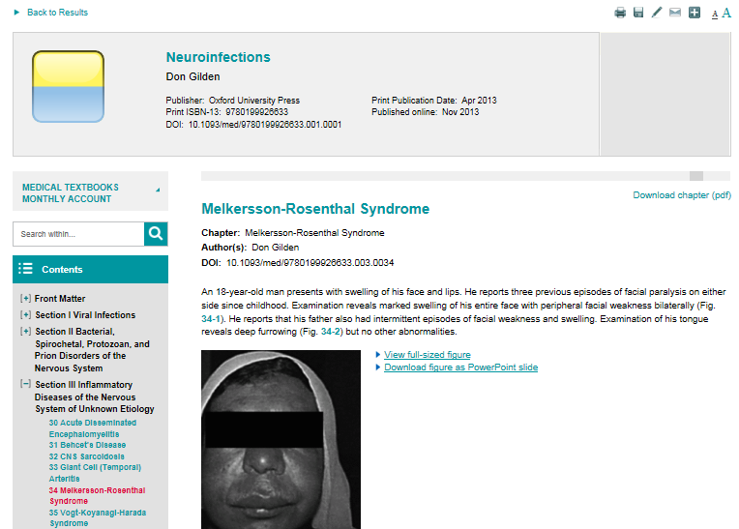
Icons at the top allow you to print the content, save it in your private work area, export the citation to your citation manager, email a link to the page and share links on social networks.
Note that chapters can be downloaded to pdf format.

Slide 15
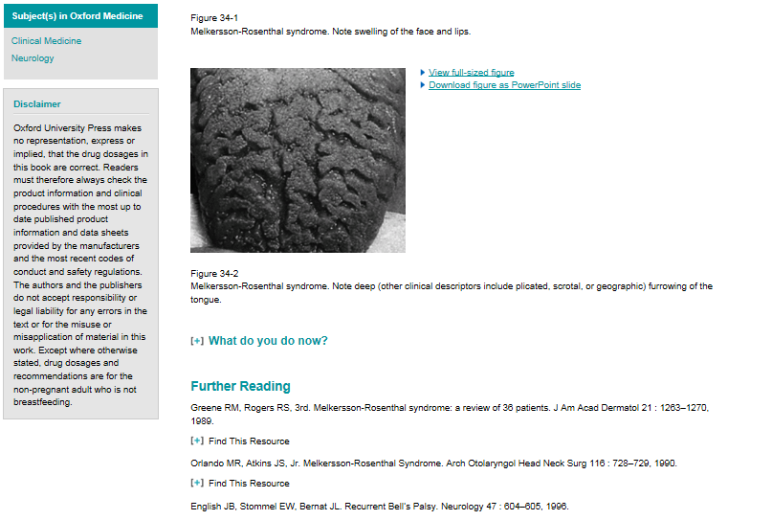
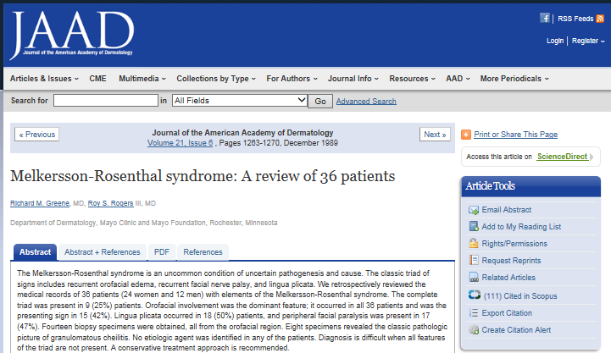
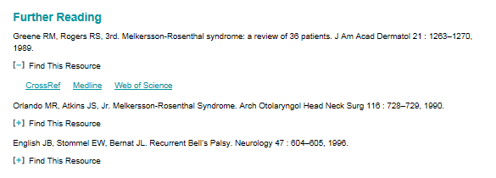
Further reading at the bottom of the chapter enables you to extend your research.

Slide 16
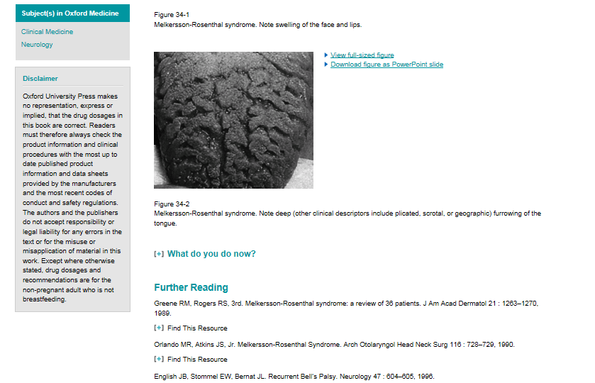
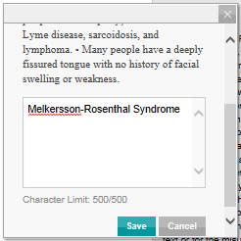
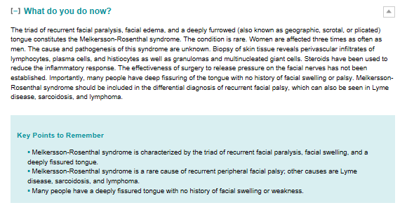
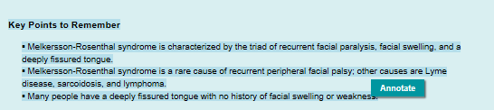
You can also annotate the text as well as enlarge and download the images to Power Point for lectures and presentations.

Slide 17
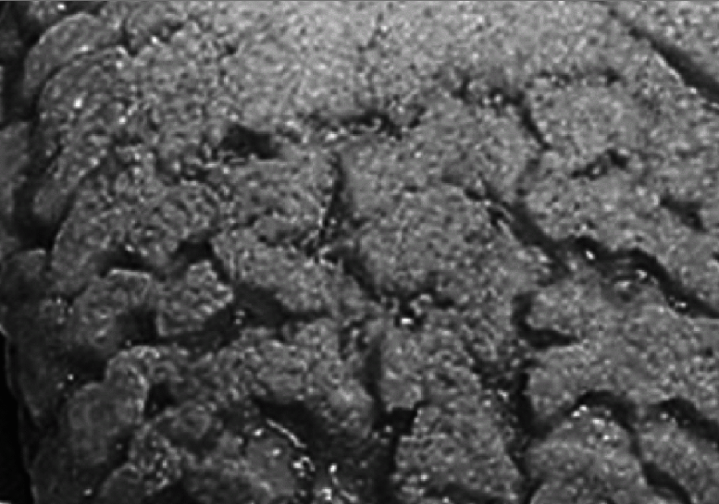
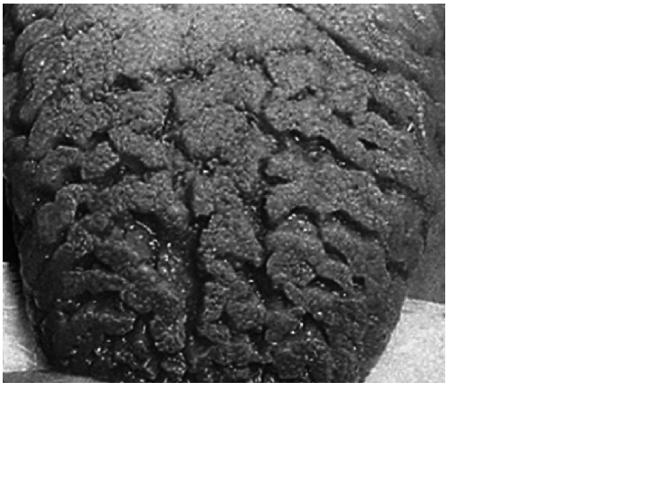
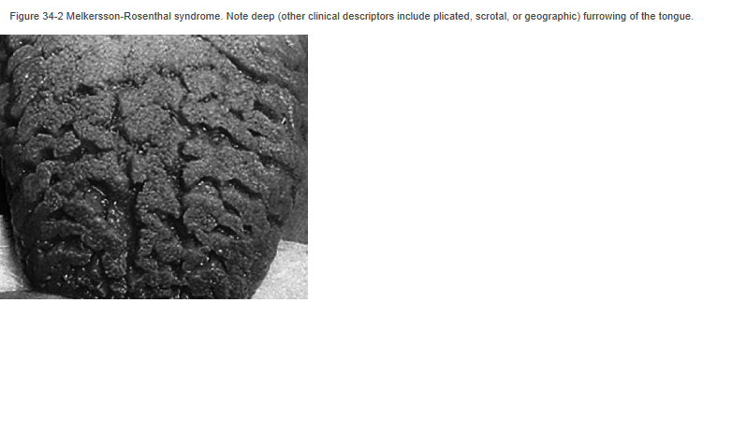

Slide 18
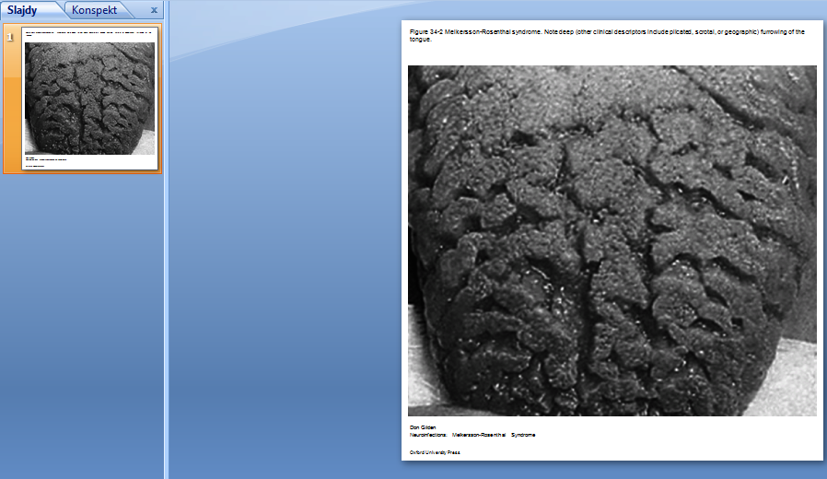

Slide 19
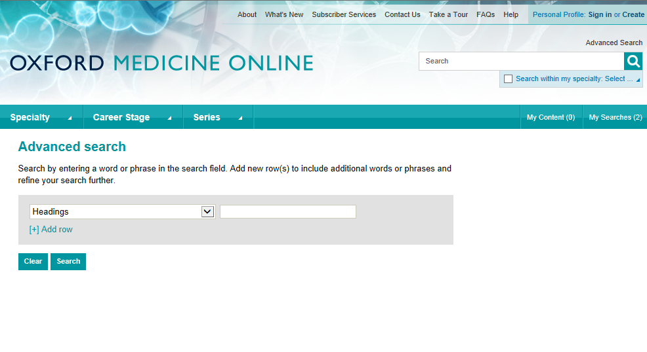
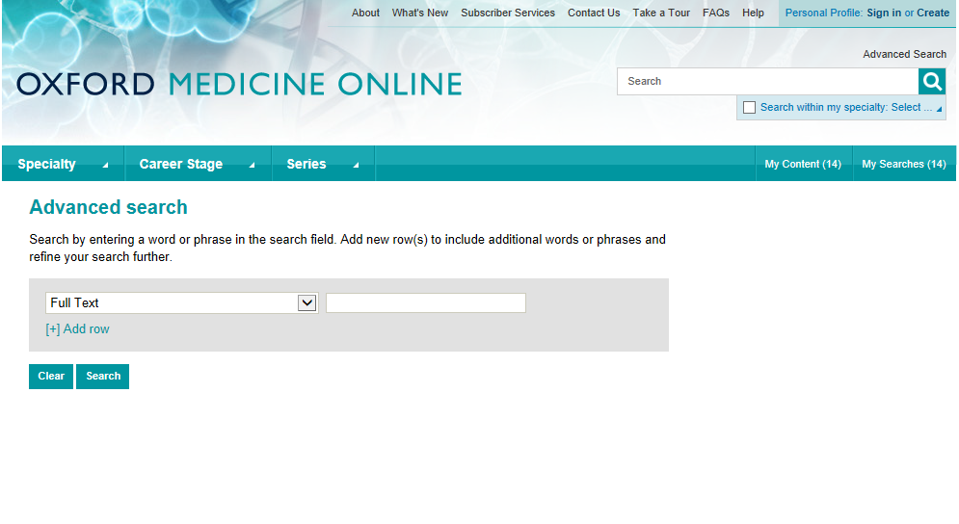
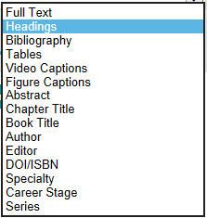
Use the Advanced search to return more focused results.

Slide 20
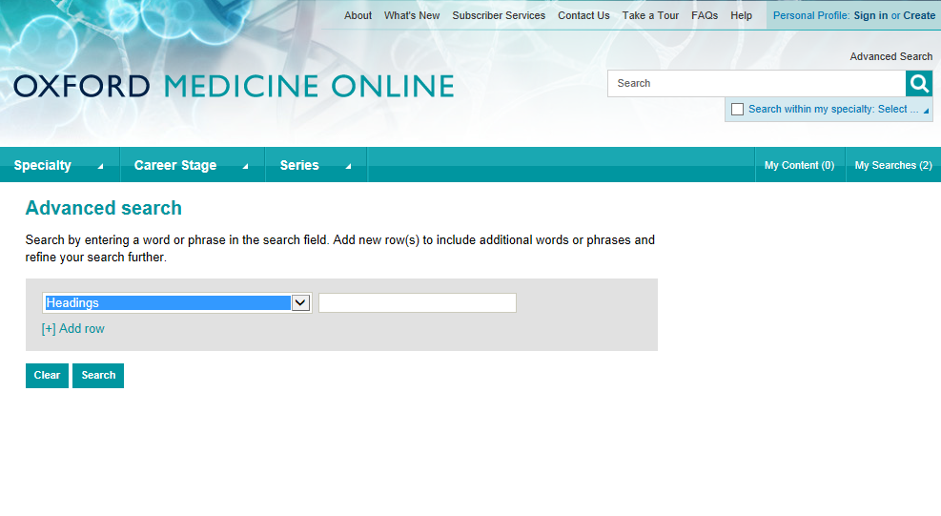
Acute Pericarditis

Slide 21
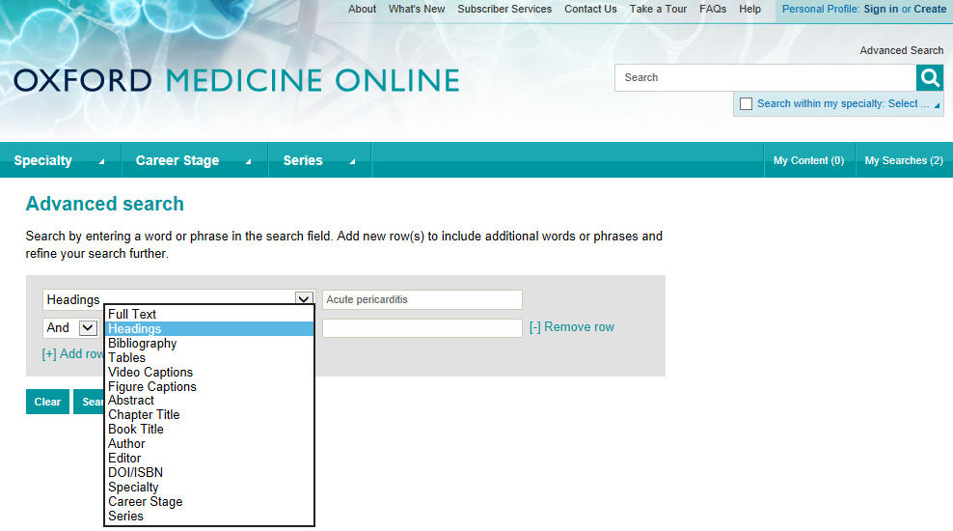

Slide 22
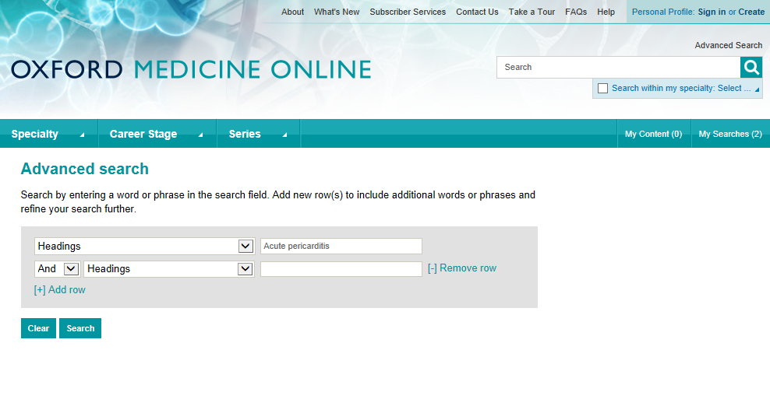
management

Slide 23
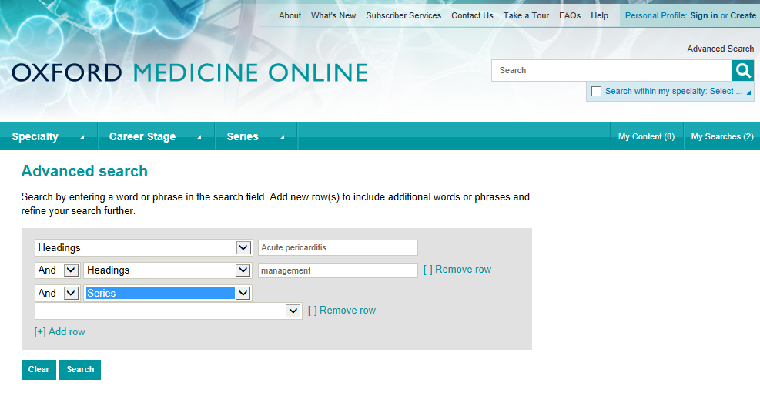
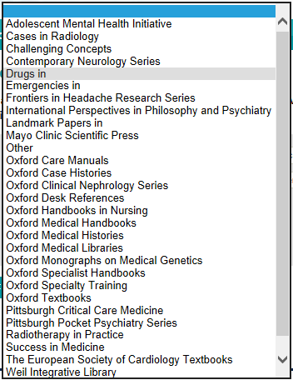

Slide 24
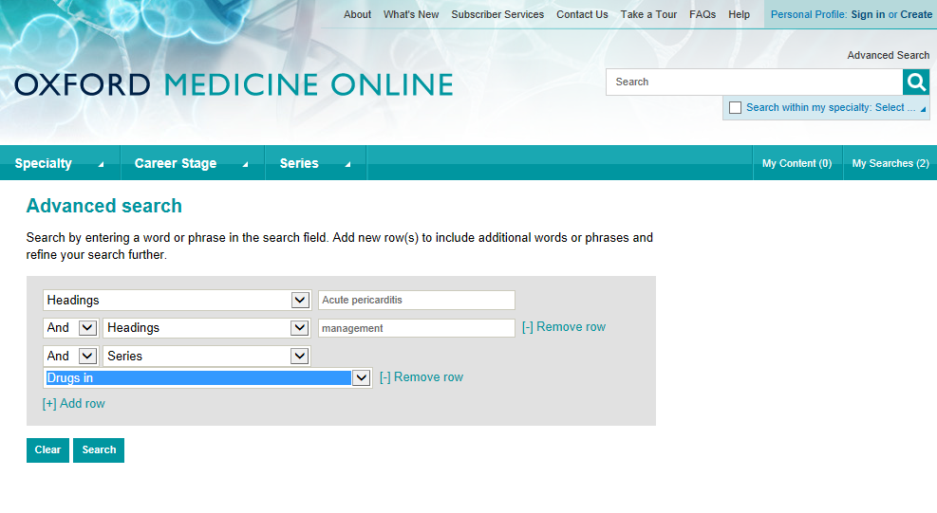

Slide 25
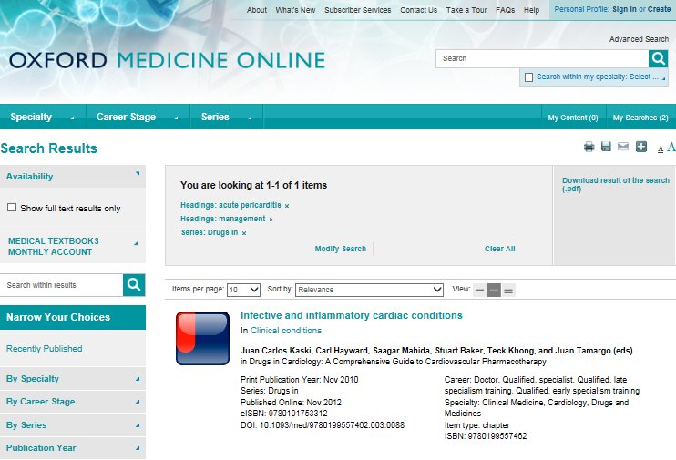

Slide 26
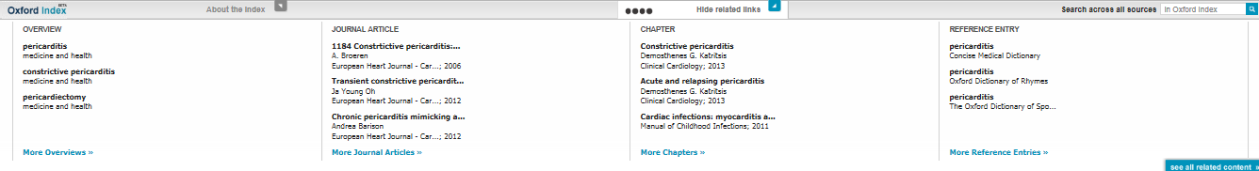
Use Oxford Index, the free discovery service, to view other related Oxford University Press online content.

Slide 27
This presentation shows only a small part of
Oxford Medicine Online.
If you want to find out more you can:
read about the portal
read the FAQs
look for a live online demo
email us at onlinemarketing@oup.com

Slide 28
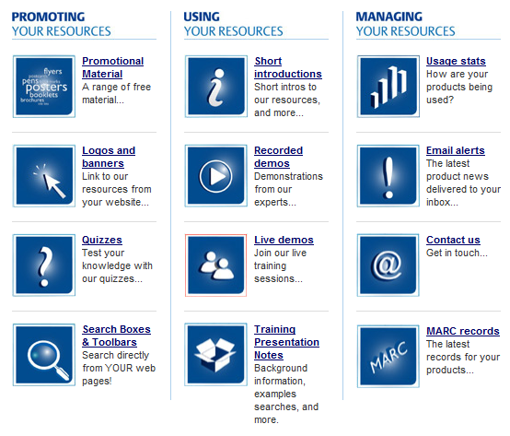
You can see similar presentations on other Oxford University Press online resources in the Librarian Resource Centre
www.oup.com/uk/academic/online/librarians

Slide 29



For further information about all online resources from Oxford, and to request institutional free trials and price quotations please contact your library supplier or Oxford University Press:
Online Products, Oxford University Press
Great Clarendon Street, Oxford, OX2 6DP
onlineproducts@oup.com
+44 (0) 1865 353705
+44 (0) 1865 353308

